Slide 1

Project on National Data Portals in Samoa and Fiji Workshop 2 Experience Sharing and SDMX/.Stat Suite Tools 27-31 January 2025 Suva, Fiji
Overview of SDMX Tools

Slide 2


Learning objectives
At the end of this session, you will be able to:
List existing SDMX software.
Identify the right tool for main SDMX and .Stat Suite related tasks.
Find additional resources regarding SDMX tooling.

Slide 3
Outline
The need for software tools
.Stat Suite
Excel Add-in
Power BI connector
Fusion Metadata Registry Workbench
R
Github

Slide 4
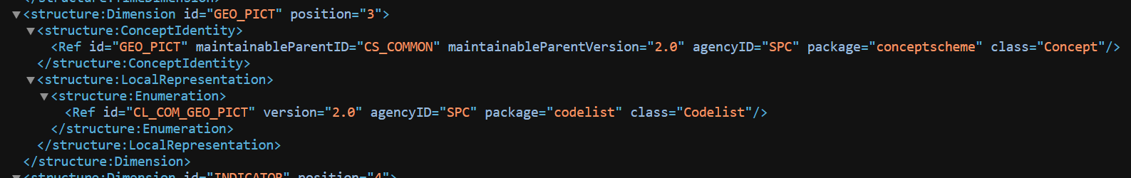
SDMX data and metadata

Slide 5
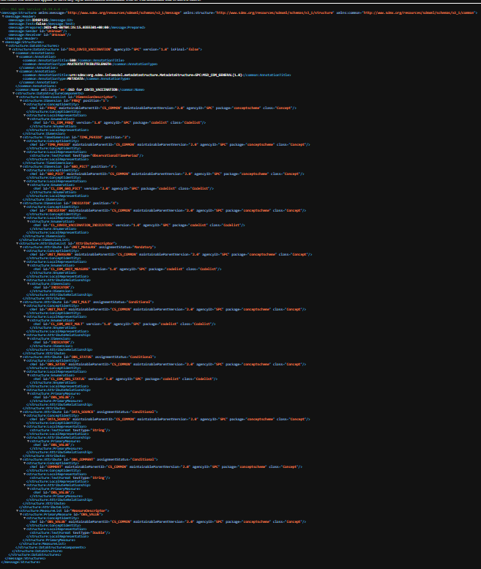
SDMX data and metadata

Slide 6
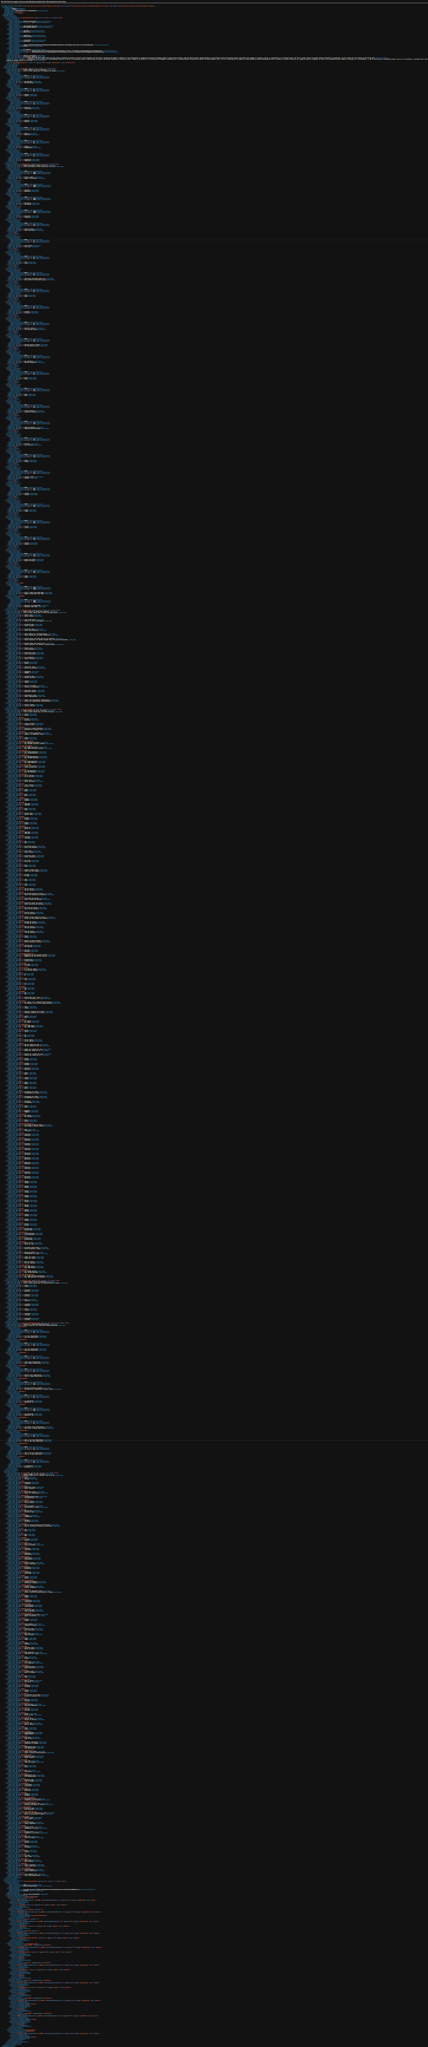
SDMX data and metadata
SDMX structures:
Rich and complex
hence
You don’t want to write them by hand

Slide 7
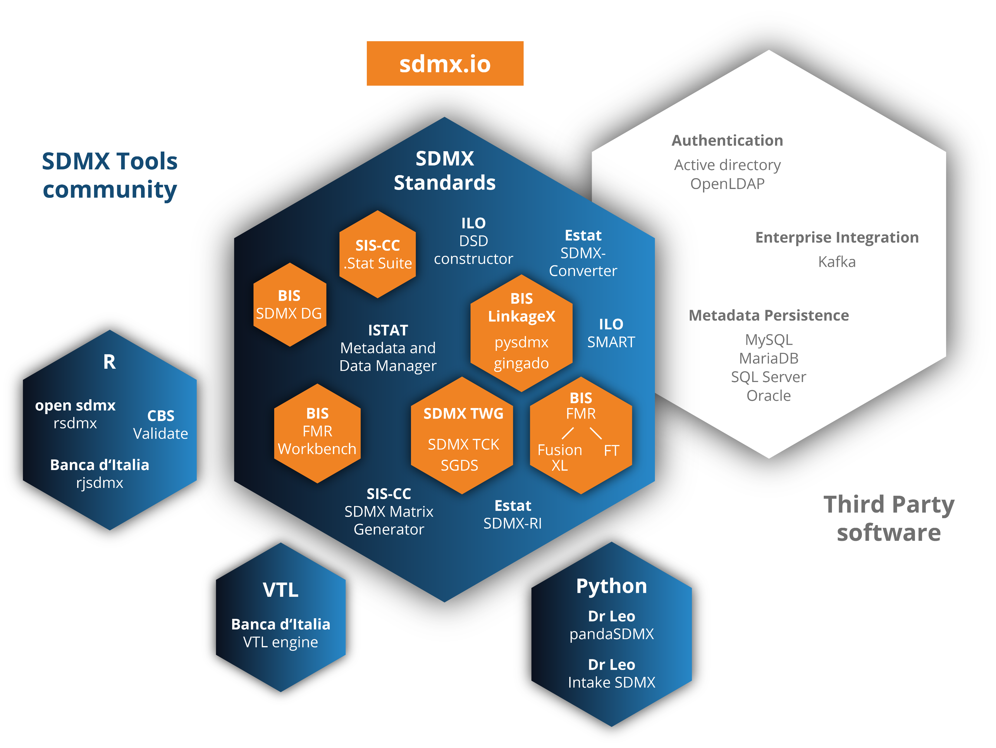
Software ecosystem

Slide 8
Software ecosystem
Available at:
sdmx.org/tools
Some are more updated
Some do the same thing

Slide 9




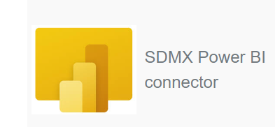

Software ecosystem

Slide 10




Software ecosystem

Slide 11


Software ecosystem
SIS-CC (OECD)

Slide 12
Software ecosystem
Apache license
SIS-CC (OECD)
MIT license

Slide 13
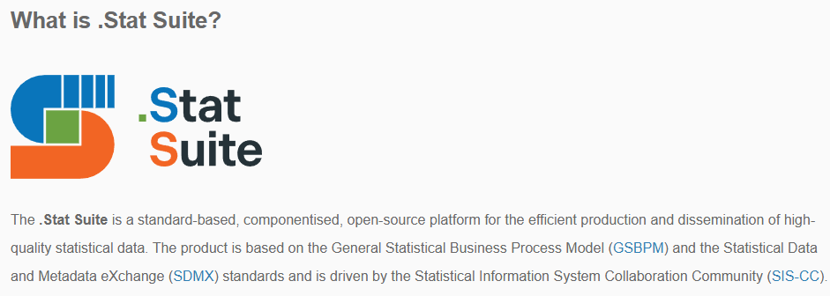
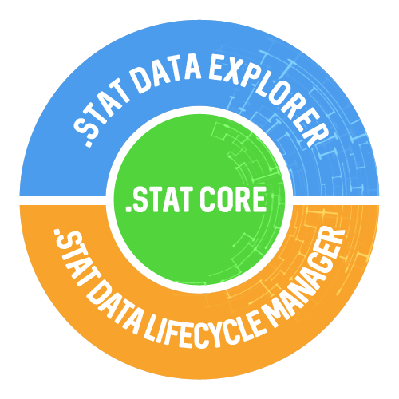


.Stat Suite

Slide 14

.Stat Core
The .Stat Core, a highly performing, secure SDMX-native Data Store based on standard protocols, to store and retrieve statistical data, structural and referential metadata, data process information and security settings.
https://sis-cc.gitlab.io/dotstatsuite-documentation/using-api/
DEMO:
Get API for data and for structure from the Data Explorer
Show transfer service Swagger interface

Slide 15
Software ecosystem
web-based application to easily find, access, and share data through a well-tuned navigation

Slide 16
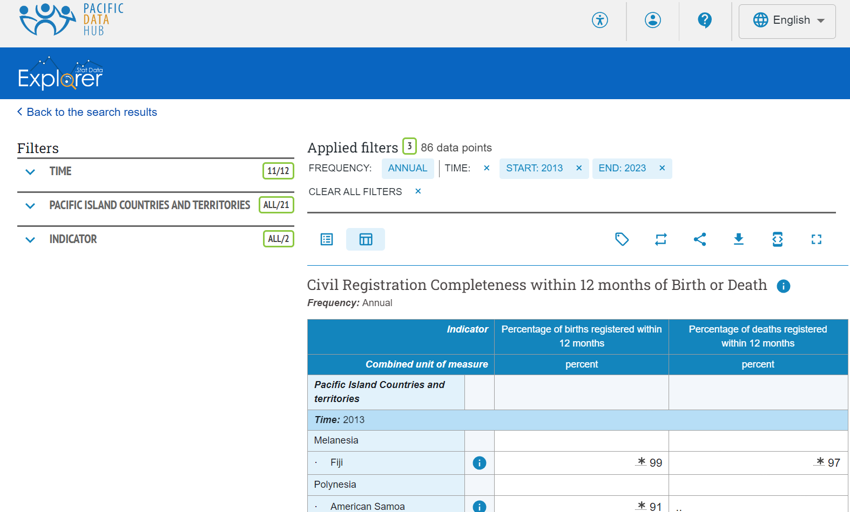
Software ecosystem

Slide 17

.Stat Data Explorer
The .Stat Suite Data Explorer, a web-based front-office application for easy finding, understanding and using of data through an efficient well-tuned navigation and search approach, appropriate data previews and contextual metadata, and download in standard formats, APIs or share features.
https://sis-cc.gitlab.io/dotstatsuite-documentation/using-de/
DEMO:
Search for data
View default table, adjust filters, adjust layout, export data, share
Full screen view, show code/labels/both, get API calls, login, contact form

Slide 18
Software ecosystem
back-office modules to efficiently and timely produce and (re-)use high quality statistical data by defining, running, automating, controlling and evaluating the underlying data processes

Slide 19
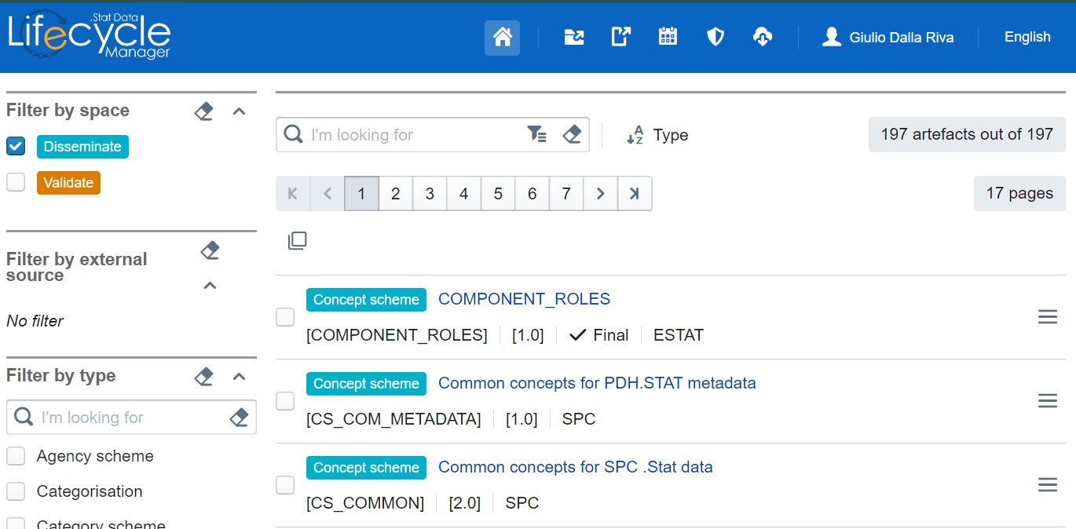
Software ecosystem

Slide 20

.Stat DLM
The .Stat Data Lifecycle Manager, a set of adaptive back-office modules to efficiently and timely produce and (re-)use high quality statistical data by defining, running, automating, controlling and evaluating the underlying data processes.
https://sis-cc.gitlab.io/dotstatsuite-documentation/using-de/
DEMO:
Login, select dataspace
Select type of SDMX object, filter, select/multi-select
General/DSD/dataflow contextual menu incl. management of dependencies and transfer across dataspaces
Upload structures, upload data & referential metadata, emnargo
Logbook, manage access rights
FWB integration

Slide 21
Software ecosystem
Excel facilitator for data and referential metadata retrieval and editing. Directly within Excel it gives access to in-progress or published data, from internal or external SDMX data sources

Slide 22
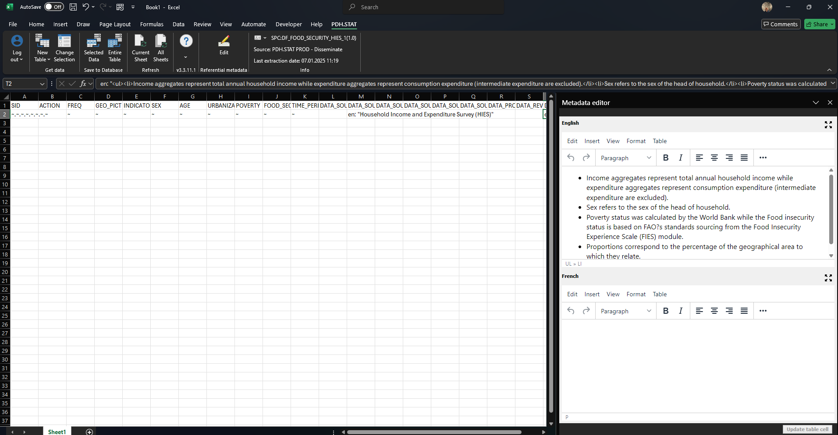
Software ecosystem

Slide 23
Software ecosystem
makes it really simple for Power-BI report builders to quickly get data from an SDMX web service without having to bother about technical things like HTTP headers and parsing labels from codes

Slide 24
Software ecosystem
remote registry browser and metadata maintenance tool which brings the strengths and capabilities of the FMR User Interface to any SDMX compliant registry, implementing an SDMX RESTful API

Slide 25
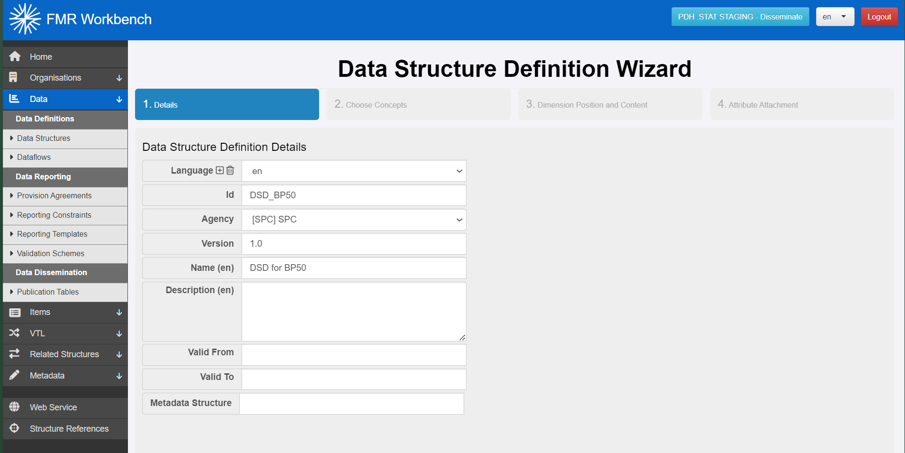
Software ecosystem

Slide 26

Software ecosystem
Builds on

Slide 27
Software ecosystem
Builds on
free to use SDMX structural metadata registry, data modelling platform and data processing engine for official statistics producers, collectors and reporters

Slide 28
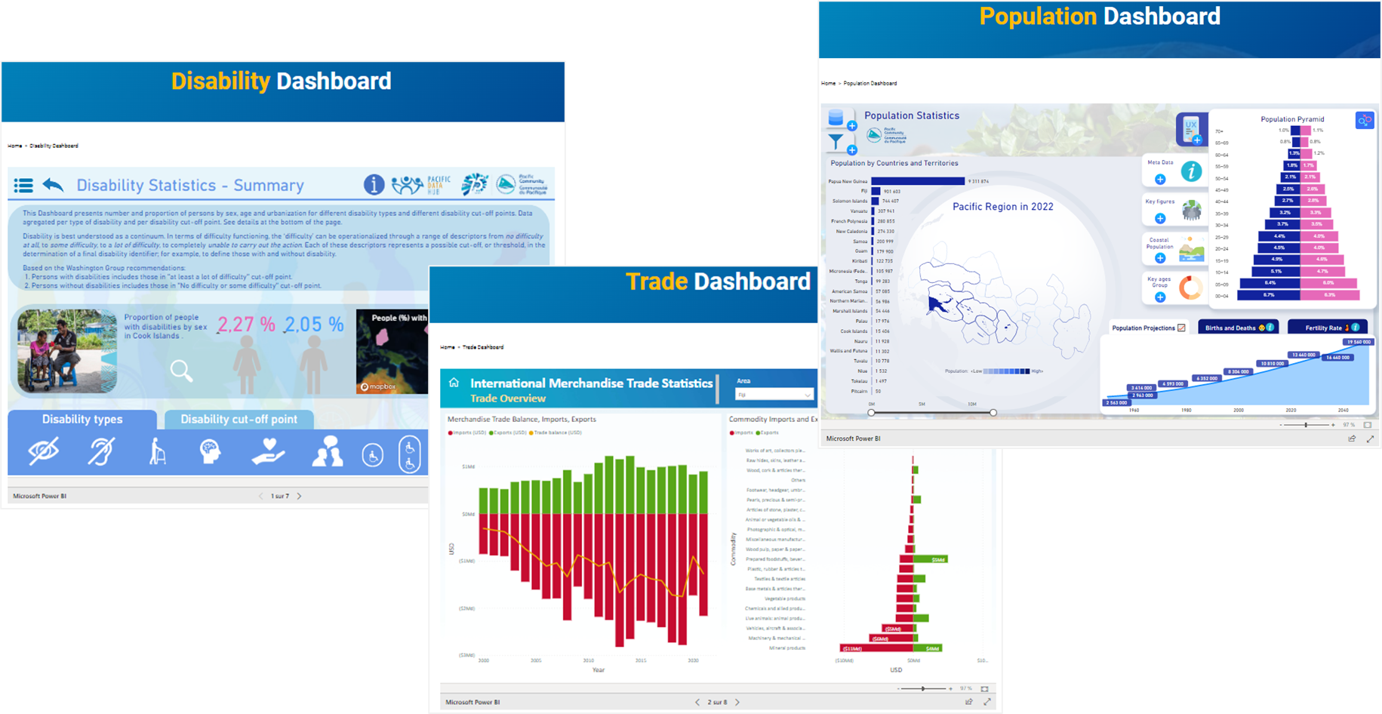
Power BI SDMX connector
https://pacificdata.org/dashboards

Slide 29
Power BI SDMX connector
https://pacificdata.org/dashboards

Slide 30

Plugin for R
rsdmx provides a set of classes and methods to read data and metadata documents exchanged through the Statistical Data and Metadata Exchange (SDMX) framework.
https://cran.r-project.org/web/packages/rsdmx/vignettes/quickstart.html

Slide 31

Plugin for Python
pandaSDMX is an Apache 2.0-licensed Python library that implements SDMX 2.1 (ISO 17369:2013), a format for exchange of statistical data and metadata used by national statistical agencies, central banks, and international organisations.
https://pypi.org/project/pandaSDMX/
pysdmx is a pragmatic and opinionated library written in Python. It focuses on simplicity, providing a subset of SDMX functionalities without requiring advanced knowledge of SDMX. Key features: SDMX information model in Python, metadata in action, data discovery and retrieval.
https://pypi.org/project/pysdmx/

Slide 32
CMS plugins
SPC developing plugins for Content Management Systems (CMS) to help fetching and visualising SDMX data on websites. Some initial versions are available for WordPress and Drupal, further development on-going.

Slide 33
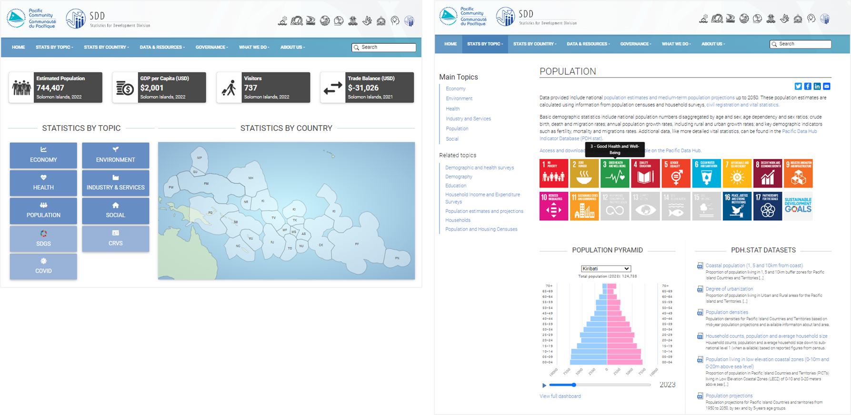
CMS plugins
https://sdd.spc.int/

Slide 34
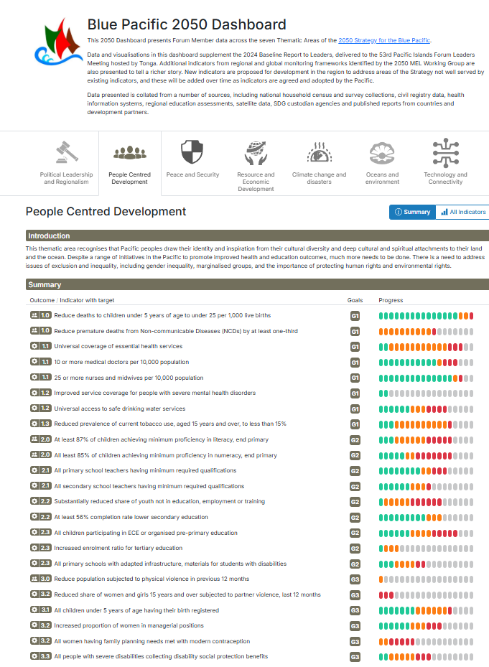
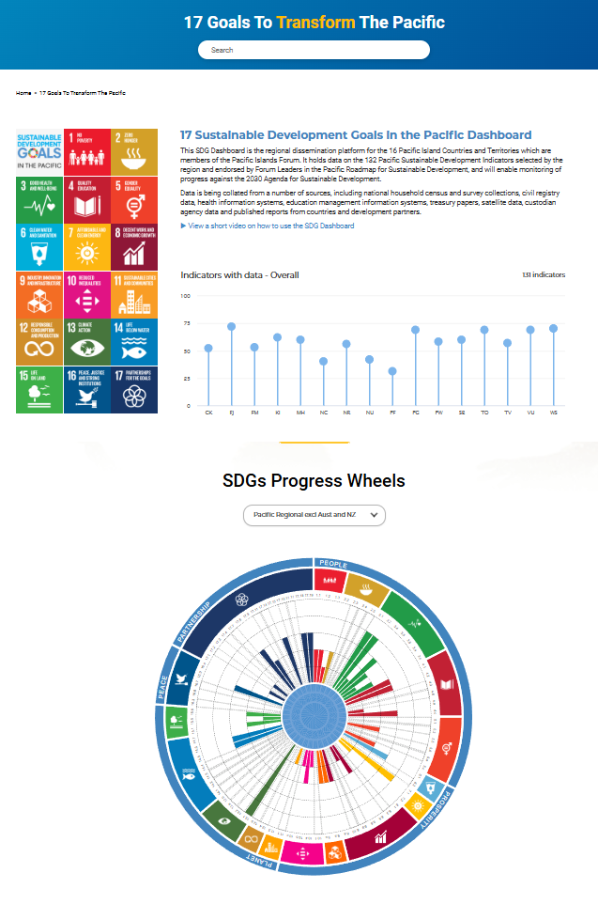
CMS plugins
https://blue-pacific-2050.pacificdata.org/people-centred-development
https://pacificdata.org/dashboard/17-goals-transform-pacific

Slide 35




More connectors
Stata connector
ArcGIS
QGIS SDMX connectors
CKAN open data catalogue integration

Slide 36
SDMX Matrix Generator
SDMX Matrix Generator is a tool to create SDMX DSDs and related artefacts (codelists, concept schemes, dataflows, constraints).
Is an Excel workbooks with forms and macros, developed by OECD for the SIS-CC.
It can be populated by importing SDMX structures from files or URLs.
Is able to generate data reporting templates.
Not only a software, it embeds a step-by-step method for structural modelling under the SDMX framework, promoting re-use and quality.
See .Stat Academy online course:
An introduction to SDMX structural modelling for data producers
https://academy.siscc.org/courses/an-introduction-to-sdmx-structural-modelling-for-data-producers/

Slide 37
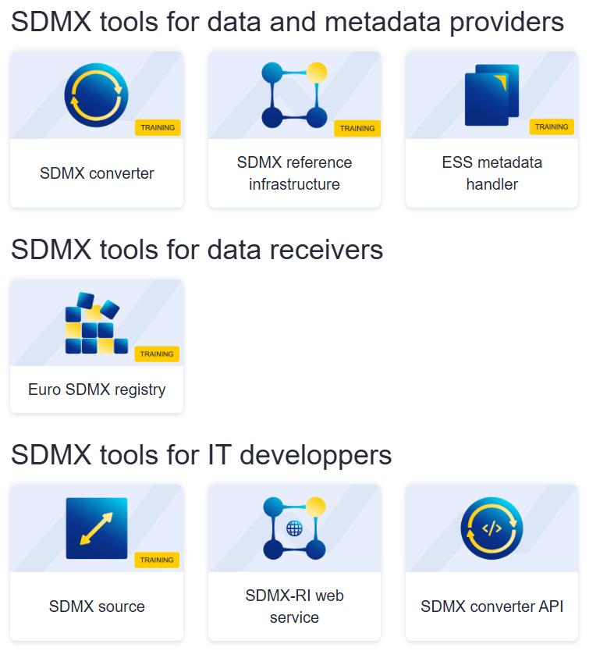
Eurostat software
https://ec.europa.eu/eurostat/web/sdmx-infospace/it-tools

Slide 38
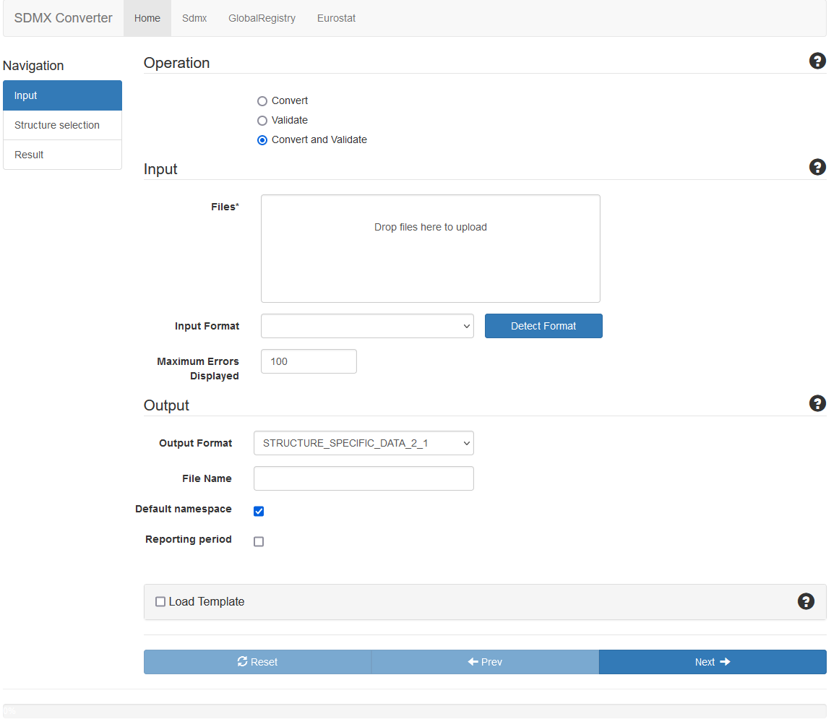
SDMX Converter
https://cros-legacy.ec.europa.eu/content/sdmx-converter-0_en
The SDMX Converter is a tool that converts statistical datasets between different SDMX and related formats.
Requires an input file and the matching SDMX DSD.
Optionally, can include structural validation of the input dataset, including codelist checks.
Optionally, the transformation service can perform transcoding using a supplied lookup table.
The SDMX Converter can be used in several forms:
As a web application with an interactive GUI.
As a command-line tool, useful for both interactive and batch processing.
As a web service that can be invoked by any SOAP/REST compliant client.
As a Java library with its own API.

Slide 39
ILO SDMX tools
SDMX query builder
SDMX Constructor | The “Constructor” is a very simple, standalone tool which is able to create and edit DSDs and their components (i.e. concept schemes and code lists) in order to generate the DSD which fits your needs and can be used by SMART to obtain the output dataset you require. It can grab concepts and associated code lists from any SDMX registry or allows to create and load them from scratch. Or it might edit an existing DSD and save it with a different id after making some changes.
Statistical Metadata-driven Analysis & Reporting Tool (SMART) | SMART allows users to generate and automate the production of analytical reports defined by means of a SDMX Data Structure Definition (DSD), either from processing micro-level data or from aggregated data by means of transcoding.
LMIS Excel Add-in | The LMIS Excel Add-in is a specialized software designed to facilitate data exchange between the .Stat Suite and Excel, particularly tailored for LMIS (Labour Market Information System) implementations. Its core features enable efficient downloading and uploading of data between Excel and the .Stat Suite platform.
https://ilostat.ilo.org/resources/sdmx-tools/

Slide 40
SDMX Istat toolkit
The SDMX Istat Toolkit is a free and open source SDMX-Based platform allowing organizations to set up in a very simple way an infrastructure that can be used successfully for building dissemination and reporting SDMX compliant databases and for implementing SDMX in terms of metadata and data management and dissemination and Open (Statistical) Data. It is composed by the following modules: Meta and Data Manager: back office web tool for SDMX metadata and data collection, transformation and publication Data Browser: web portal for sharing, integrating and disseminating multidimensional datasets Excel2CSV: desktop utility for converting statistical Excel tables to CSV files CsvHandler: desktop utility for CSV formatted datasets transformation
https://github.com/SDMXISTATTOOLKIT

Slide 41
Additional resources
SDMX tools page
https://sdmx.org/?page_id=4500
SDMX learning resources
https://sdmx.org/?page_id=2555
SDMX User Forum
https://www.yammer.com/unstats/#/threads/inGroup?type=in_group&feedId=121500557312
sdmx.io
https://www.sdmx.io/
.Stat Academy
https://academy.siscc.org/
ADB SDMX Tools Course
https://elearn.adb.org/enrol/index.php?id=520

Slide 42
Conclusions
Many free and open-source software exist for working with SDMX.
Most relevant ones in the context of a .Stat Suite data portal are Data Explorer, Data Lifecycle Manager (DLM), FMR Workbench and Excel add-in.
Once data is in a .Stat Suite data portal, it can be used with connectors and plugins from office tools (Excel, Power BI), statistical tools (R, Python), web development tools (WordPress, Drupal) and more.
Resources are available online for finding and learning to use SDMX software (SDMX tools page, sdmx.io, .Stat Academy).

Slide 43
Exercise
Navigate to https://www.sdmx.io/
Find download links and manual for the software products we are going to use in the workshop

Slide 44
Discussion and Q&A
https://stats-test-fwb.pacificdata.org/
https://stats-test-dlm.pacificdata.org/
https://stats-test.pacificdata.org/

